Slide 1
JOptionPane
Juan Pablo Enríquez Pedroza

Slide 2
Constructores
JOptionPane()
JOptionPane(Object message)
JOptionPane(Object message, int messageType)
JOptionPane(Object message, int messageType, int optionType)
JOptionPane(Object message, int messageType, int optionType, Icon icon)
JOptionPane(Object message, int messageType, int optionType, Icon icon, Object[] options)
JOptionPane(Object message, int messageType, int optionType, Icon icon, Object[] options, Object initialValue)
Notes:
Me parece que aquí no es necesario crear una instanciación del objeto.

Slide 3
Constantes

Slide 4

int optionType
DEFAULT_OPTION
YES_NO_OPTION
YES_NO_CANCEL_OPTION
OK_CANCEL_OPTION

Slide 5

int messageType
ERROR_MESSAGE
INFORMATION_MESSAGE
WARNING_MESSAGE
QUESTION_MESSAGE
PLAIN_MESSAGE

Slide 6
Métodos
Notes:
Sobrecargados, en su mayoría

Slide 7
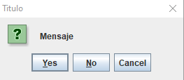
static int showConfirmDialog
showConfirmDialog(Component parentComponent, Object message)
showConfirmDialog(Component parentComponent, Object message, String title, int optionType)
showConfirmDialog(Component parentComponent, Object message, String title, int optionType, int messageType)
showConfirmDialog(Component parentComponent, Object message, String title, int optionType, int messageType, Icon icon)

Slide 8
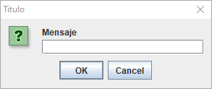
static String showInputDialog
showInputDialog(Object message)
showInputDialog(Object message, Object initialSelectionValue)
showInputDialog(Component parentComponent, Object message)
showInputDialog(Component parentComponent, Object message, Object initialSelectionValue)
showInputDialog(Component parentComponent, Object message, String title, int messageType)
static Object showInputDialog(Component parentComponent, Object message, String title, int messageType, Icon icon, Object[] selectionValues, Object initialSelectionValue)

Slide 9
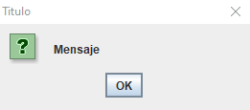
static void showMesaggeDialog
showMessageDialog(Component parentComponent, Object message)
showMessageDialog(Component parentComponent, Object message, String title, int messageType)
showMessageDialog(Component parentComponent, Object message, String title, int messageType, Icon icon)

Slide 10
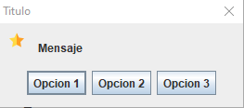
static int showOptionDialog
showOptionDialog(Component parentComponent, Object message, String title, int optionType, int messageType, Icon icon, Object[] options, Object initialValue)

